Slide 1

What makes a good Storyboard?
“WABOLL & WAGOLL”

Slide 2
What makes a good Storyboard We need to look at all the factors that would affect our Storyboard. 1. Too much information. The screen can hold only so much information at one time, so don’t try to cram many very large, very detailed images, and large blocks of text on the same screen. 2. Inconsistent Design. Your storyboard needs to have a consistent design through the use of colour and layout, with a set of about three variations for the type of information on the page. Sections may have different colours and the same general layout and image "looks", or sections may have slightly different layout and use the same colours. If you use different layouts and colours, you run the risk of your viewers becoming confused and lost. 3. Action. Show action in the form of directional arrows A B 4. Title. Make sure your animation starts with a title opening shot. The title will help viewers understand the plot/theme of the animation. 5. Not Enough Information. This could confuse you later when you put together your animation and refer to your storyboard later on. You need to make sure there is enough information on your storyboard so someone else reading it can see how your story will go together.

Slide 3
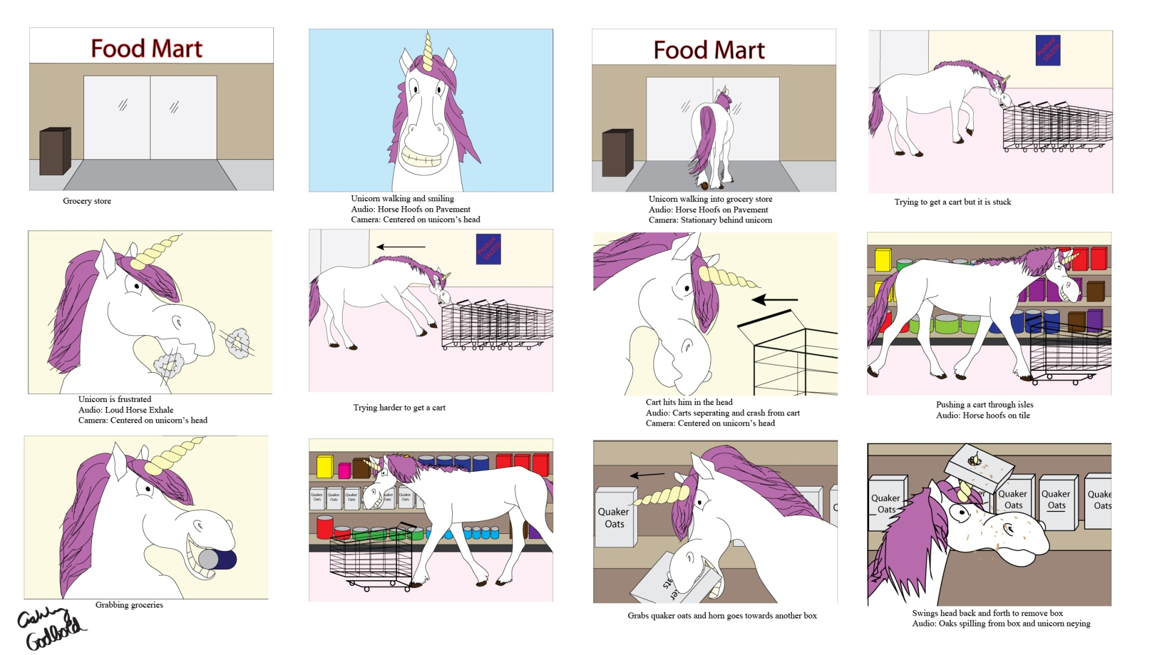
What makes a good Storyboard WAGOLL:

Slide 4
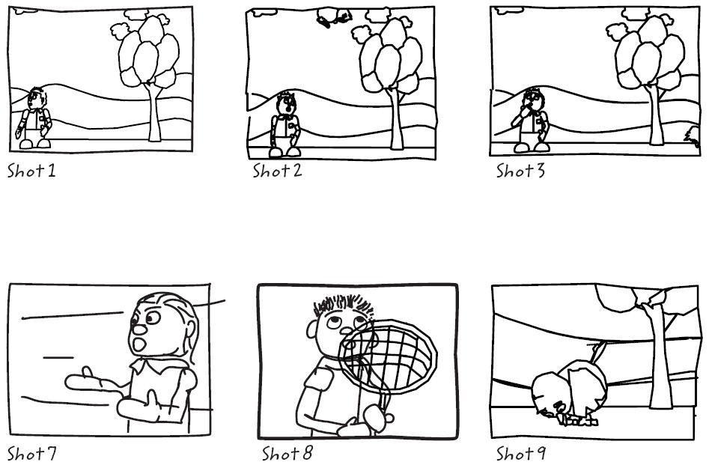
What makes a bad Storyboard WABOLL:

